Slide 1

Project Title - Airbnb Hotel Booking Analysis Project
[Adithya N K]
[INTERNSHIP_172663295366ea53f910591]

Slide 2

PROBLEM STATEMENT
Project Description:
This project analyzes Airbnb booking data to understand pricing patterns, host performance, and customer preferences across different neighborhoods in New York City. The analysis helps identify what factors influence listing prices and popularity.

Slide 3
Project Description
This project analyzes Airbnb booking data to understand pricing patterns, host performance, and customer preferences across different neighborhoods in New York City. The analysis helps identify what factors influence listing prices and popularity.

Slide 4

WHO ARE THE END USERS?
1. Airbnb Hosts:
Understand competitive pricing strategies
Identify what makes listings successful
Learn from top-performing hosts
2. Travelers:
Find best value accommodations
Understand neighborhood pricing patterns
Make informed booking decisions
3. Airbnb Platform:
Insights for improving host guidelines
Data-driven recommendations for hosts

Slide 5

Technology Used
Python - Data analysis and processing
Pandas - Data manipulation and cleaning
Matplotlib & Seaborn - Data visualization
Jupyter Notebook - Development environment

Slide 6
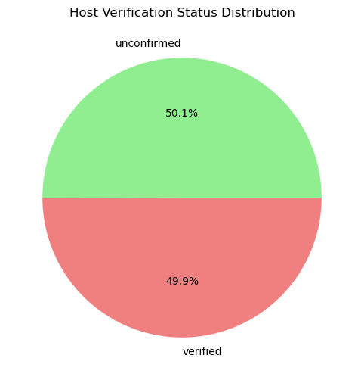
RESULTS1
Demo Link

Slide 7
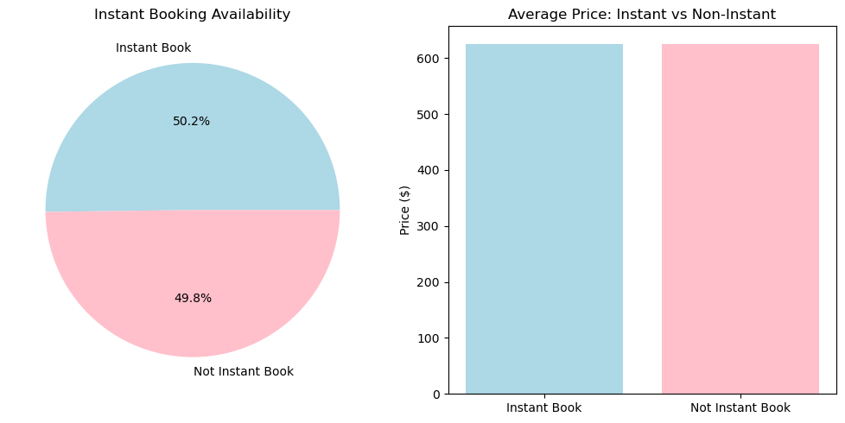
RESULTS2
Demo Link

Slide 8
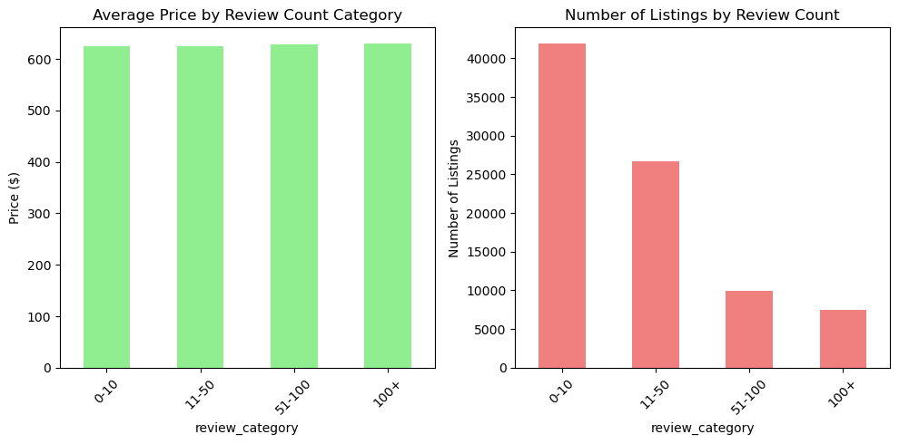
RESULTS3
Demo Link

Slide 9
GitHub repository
https://github.com/NKAdithya/VOIS_AICTE_Oct2025_AdithyaNK.git
Demo Link

Slide 10

Getting started with Basics of Python Certificate

Slide 11
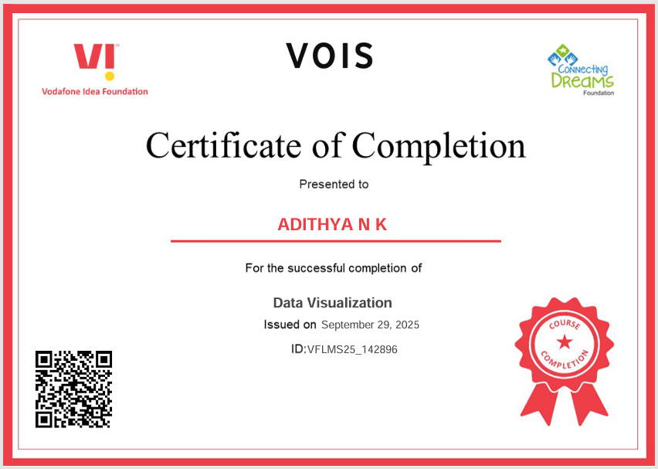
Data Visualization Certificate

Slide 12
Thank you
.
.

